Slide 1



PREDICTION OF BOOKING CANCELLATION IN HOTEL INDUSTRY
TEAM MEMBERS
1. Kshitij Rampurkar
2. Venkatarajesh
3. Anandu P N
4. Srushti Avlani
Mentor – Mr Srikar Muppidi

Slide 2
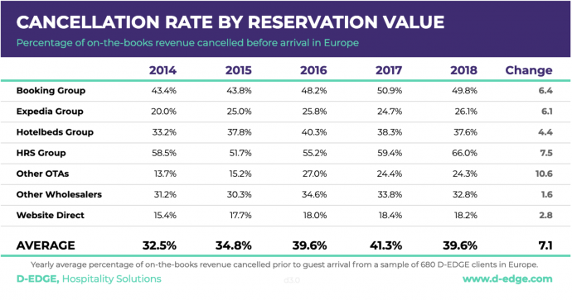
PROBLEM STATEMENT
With increase in the spending capacity of the people, both leisure and business travel spending has seen YoY growth over the past 5 years.
The hotel industry has been consistently growing with The Global Hotel Industry revenue in 2016/17 at a staggering value of $550 Bn and increasing in 2018, 2019 and 2020.
Hotel cancellations have been rising in the past few years due to the presence of online websites (OTA) like Booking.com, expedia.com, etc.
Numerical data shows that with the exception of 2018, every single channel has observed a marked increase in cancellation rate YoY.
So what can hotels do to maximize their revenues? Some ways are-
Increasing the number of days until the customer can cancel their booking free of cost, hence giving you more time to resell the room.
But due to competition we have to restrict this so that we don’t loose customers.
Hence we can use Machine Learning to predict whether a booking made will be cancelled or not in the future.

Slide 3
DATA PREPROCESSING
Features – 32
Rows – 119390
Numerical Features – 19
Categorical Features – 13
Null Value Treatment
According to the research paper null values are not missing values rather they are not applicable or unknown Values.
For Children the null means parents do not have any child. Hence replace it with 0.
For country we replace null values by unknown.
For agent, the booking was not done by any agent, hence replace null values by 0 which represents that the booking wasn't done by the agent.
As we see that company column has largest number of null values. Hence, we drop this column.
Duplicate and Noisy Value Treatment
In our dataset, we have 32001 duplicate rows. Hence, we drop these duplicate rows. After removal of these duplicate rows, we have 87389 rows left.
Along with duplicate rows, we have 166 rows wherein the booking is made, but the number of adults, children and babies is zero. These rows indicate some anomaly in the booking entry. Hence, we remove these rows.
From the 5-point summary of the data, we observe that minimum value in ‘adr’ column is -6.38 which is not possible. Hence, we remove the rows containing negative ‘adr’ values.
After performing all these steps, we finally have data which has 87222 rows and 31 columns.
Attribute | Null Value Percentage
children | 0.00335
country | 0.408744
agent | 13.686238
company | 94.306893

Slide 4
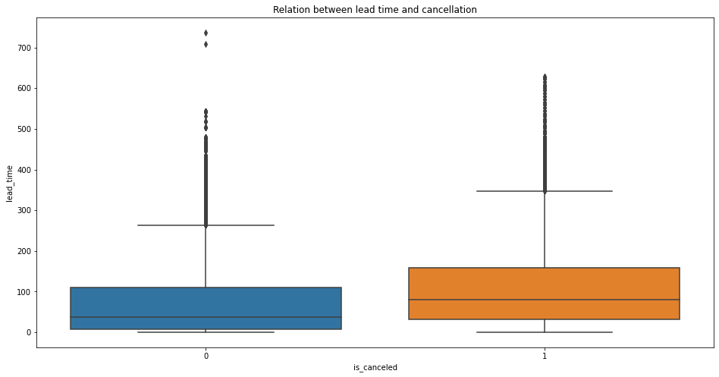
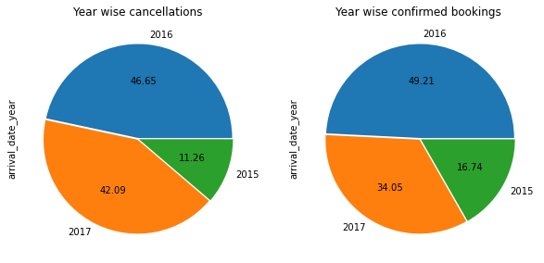
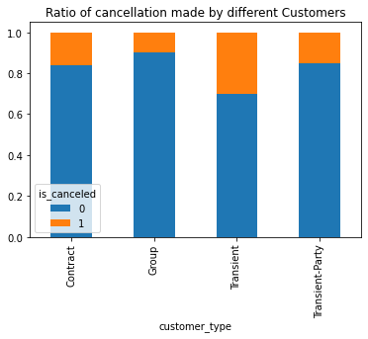
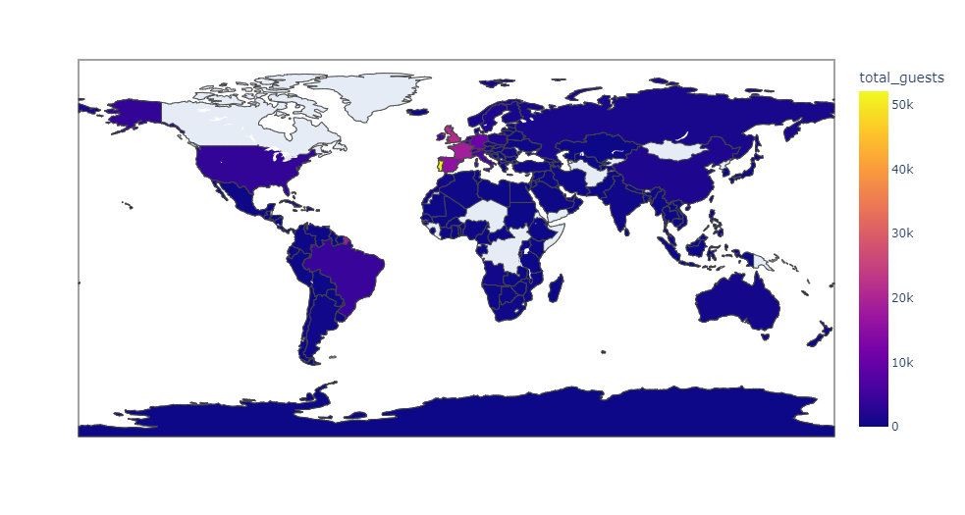
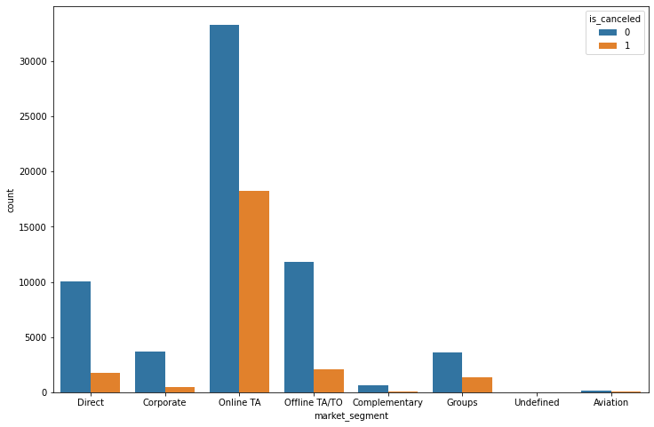
EXPLORATORY DATA ANALYSIS (EDA)

Slide 5
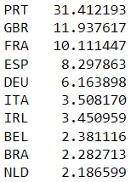
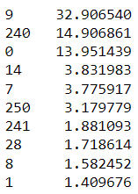
FEATURE ENGINEERING AND TRANSFORMATION
Country
Feature Engineering
Total Customer from children, babies, adults columns
Total bookings from previous cancellations and previous bookings not cancelled columns
Arrival date from day, month, year columns
Room change from assigned room type and booked room type
Encoding Categorical Features
Mapped the month column with its respective numeric value.
Certain categorical variables(country, agent) haves high cardinality
Used various encoding techniques for such variables such as binary encoding, base-N encoding, grouping the categories based on various conditions.
Dummy encoding for the remaining variables
Agent
Numeric Features
Power Transformer to reduce the skewness in the data
MinMax Scaler to scale the data between 0 and 1.

Slide 6
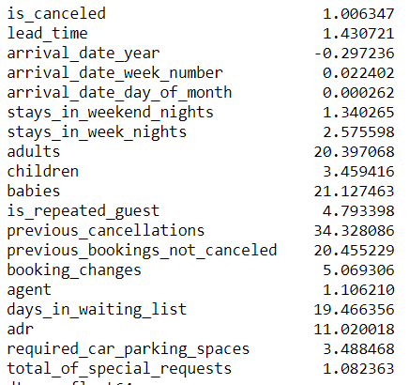
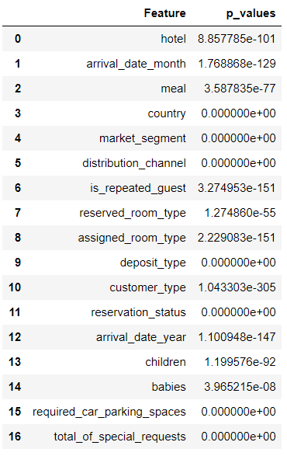
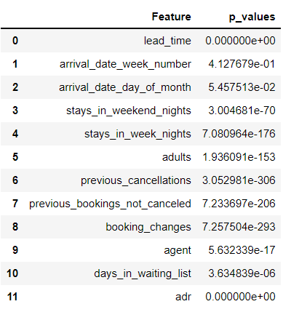
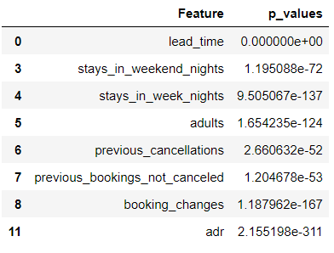
STATISTICAL TEST
Skewness
Chi2_Contigency
Mann-Whitney U test
Anova test

Slide 7
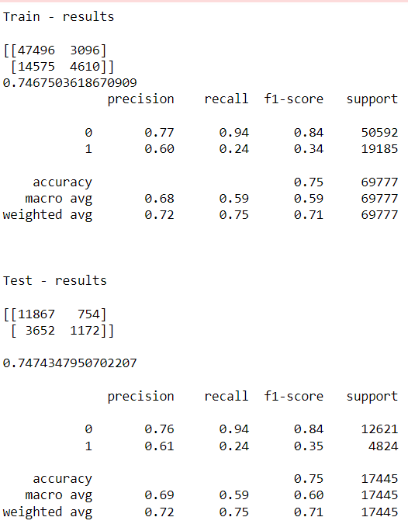
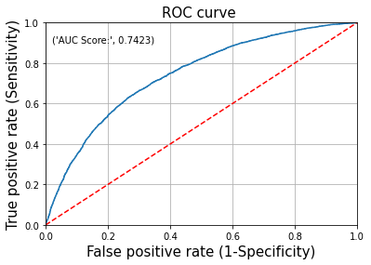
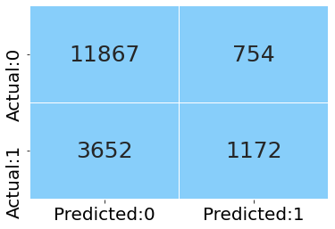
BASELINE MODEL (LOGISTIC REGRESSION)
Built a baseline Logistic Regression model by label encoding all the categorical features and keeping the numeric features as it is.
The model is not overfitting
We get an accuracy score of 0.75
Precision of 0.61 and recall of 0.24 for class label 1
F1 score of 0.35 for class label 1

Slide 8
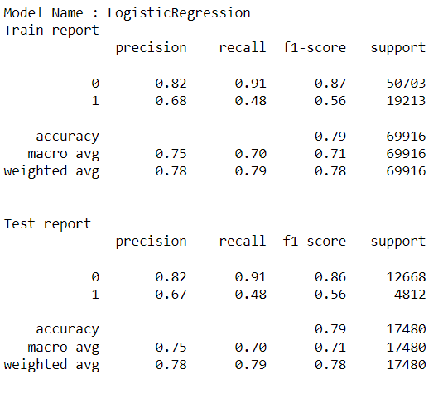
IMPROVED LOGISTIC REGRESSION MODEL
Logistic Regression model is again trained on the data on which feature engineering, encoding, scaling and transformation has been done
Also due to presence of moderate amount of class imbalance, various sampling techniques are applied such as under sampling (Random, Near Miss, Tomek links), over sampling, SMOTE.
The model is not overfitting
We get an accuracy score of 0.79
Precision of 0.67 and recall of 0.48 for class label 1
F1 score of 0.56 for class label 1
The model performance has improved compared to the base model
Along with this regression model, various other non linear models were also built such as Random Forest, AdaBoost, XG Boost.
But from all these models we couldn’t achieve the desired accuracy, precision and recall.

Slide 9
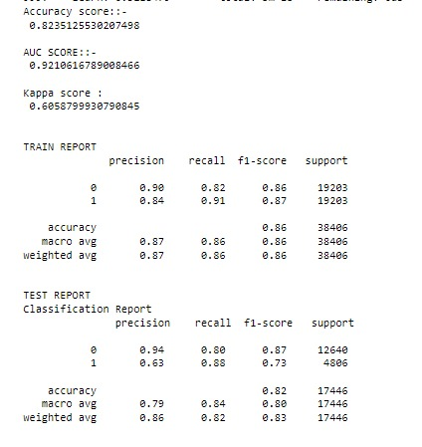
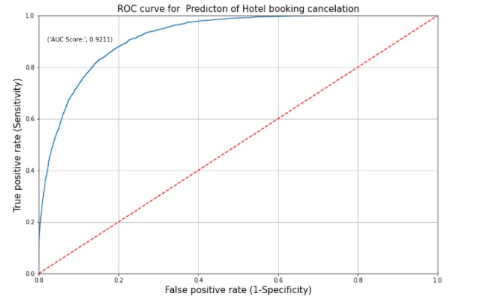
CATBOOST MODEL WITH UNDER SAMPLING
In order to deal with high cardinality in the data, we train a CatBoost model.
“CatBoost” name comes from two words “Category” and “Boosting”.
It can be used without any explicit pre-processing to convert categories into numbers.
It is a high performing Gradient Boosting on Decision Trees.
The model is not overfitting
We get an accuracy score of 0.82
Precision of 0.63 and recall of 0.88 for class label 1
F1 score of 0.73 for class label 1

Slide 10
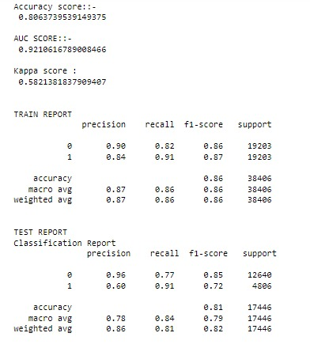
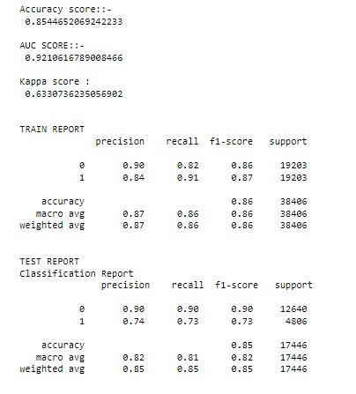
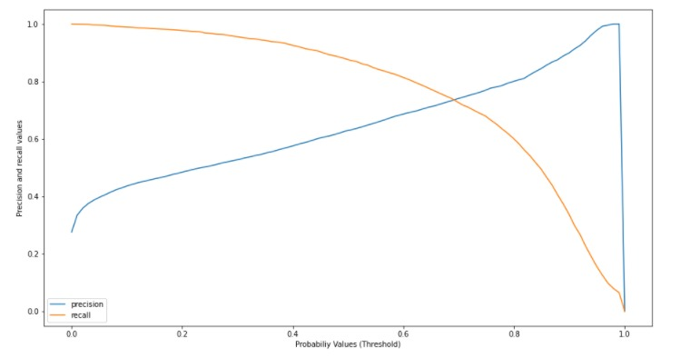
PRECISION/RECALL TRADE-OFF
Case 1 : Best Recall with decent accuracy
Case 2 : Importance to both Precision and Recall

Slide 11
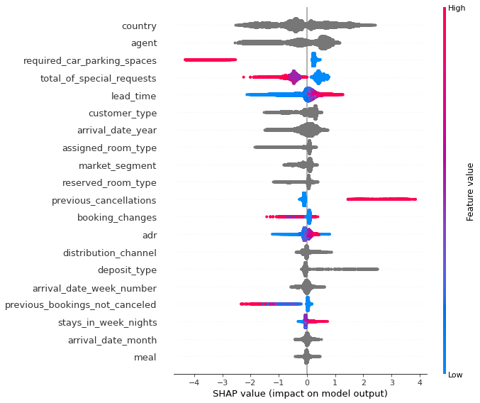
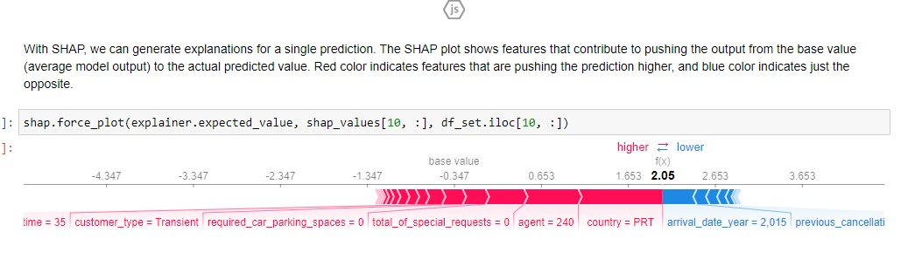
Business Recommendations
Restrict the number of days until the customer can cancel their booking free of cost.
Also reduce the lead time a customer can make the booking so that it can lead to lesser cancellations.
Keep a report of the customers cancelling their booking previously and target them with more offers so that they don’t cancel the booking next time.
Give certain offers, services to the customers staying for more nights so that they don’t cancel the booking.
Challenges
High cardinality in the categorical columns
Challenges faced on robust model tuning for all the models.
Scope
Perform hyper parameter tuning
Explore robust data sampling technique to address moderate class imbalance

Slide 12
THANK YOU!

